Slide 1
COMP3050 Cloud Computing Technology

Slide 2


Introduction to the course concepts

Slide 3

Cloud Computing Overview

Slide 4
Intended learning outcomes
After completing this topic, you will:
Understand the concept and origins of cloud computing
Appreciate why cloud computing matters
Be aware of its disadvantages

Slide 5
Cloud computing definitions
What is cloud computing?
How would you define it?

Slide 6
Cloud computing definition (1)
Cloud computing is the delivery of different services through the Internet, which includes tools and applications like data storage, servers, databases, networking, and software.

Slide 7
Cloud computing definition (2)
Cloud computing is a general term for anything that involves delivering hosted services over the internet.
These services are divided into three main categories or types of cloud computing: infrastructure as a service (IaaS), platform as a service (PaaS) and software as a service (SaaS).

Slide 8
Cloud computing definition (3)
Cloud computing is the on-demand availability of computer system resources, especially data storage (cloud storage) and computing power, without direct active management by the user.
Large clouds often have functions distributed over multiple locations, each location being a data center.
Cloud computing relies on sharing of resources to achieve coherence and typically using a "pay-as-you-go" model which can help in reducing capital expenses but may also lead to unexpected operating expenses for unaware users.

Slide 9
Cloud computing definition (3)
Cloud computing is the on-demand availability of computer system resources, especially data storage (cloud storage) and computing power, without direct active management by the user.
Large clouds often have functions distributed over multiple locations, each location being a data center.
Cloud computing relies on sharing of resources to achieve coherence and typically using a "pay-as-you-go" model which can help in reducing capital expenses but may also lead to unexpected operating expenses for unaware users.

Slide 10
There are other definitions in textbooks, research papers and online
They show different perspectives of cloud computing
You can study them if you are interested

Slide 11
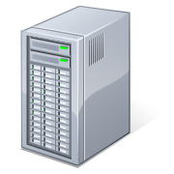
What is Cloud Computing
Shared pool of configurable computing resources
On-demand network access
Provisioned by the Service Provider
Applications
Services
Computer Network
Storage (Database)
SERvers

Slide 12
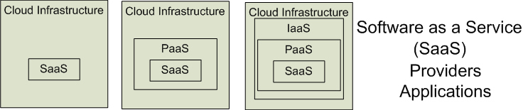

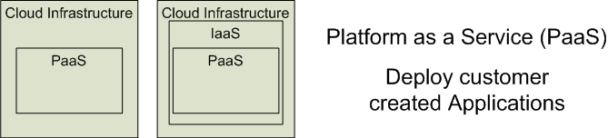

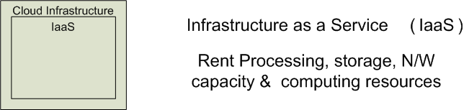


Cloud Service Models
Software as a Service (SaaS)
Platform as a Service (PaaS)
Infrastructure as a Service (IaaS)
SalesForce CRM
LotusLive
Google App Engine

Slide 13
Cloud deployment models (1)
Public clouds
Provide their services on servers and storage on the Internet.
These are operated by third-party companies, who handle and control all the hardware, software, and the general infrastructure.
Clients access services through accounts that can be accessed by just about anyone.
Private clouds
Are reserved for specific clientele, usually one business or organization.
The firm's data service center may host the cloud computing service.
Many private cloud computing services are provided on a private network.
Hybrid clouds
A combination of both public and private services.
This type of model allows the user more flexibility and helps optimize the user's infrastructure and security.

Slide 14
Cloud deployment models (2)
Community cloud
It allows systems and services to be accessible by a group of organizations
It is a distributed system that is created by integrating the services of different clouds to address the specific needs of a community, industry, or business
The infrastructure of the community could be shared between the organization which has shared concerns or tasks
It is generally managed by a third party or by the combination of one or more organizations in the community
Multi-cloud
Employing multiple cloud providers at the same time
It’s similar to the hybrid cloud deployment approach, which combines public and private cloud resources
Instead of merging private and public clouds, multi-cloud uses many public clouds
Improves availability of the services – when one cloud fails, another is available

Slide 15
Who uses cloud?
The short answer is: everyone.
From your phone and your car to your smart watch and your favorite food delivery app, the cloud is everywhere.
But cloud computing is especially powerful for businesses
Companies use it for routine tasks like
data protection
software development
data analytics
disaster recovery
virtual desktops
server virtualization
customer-facing applications

Slide 16
Cloud computing examples

Slide 17
Tencent Meeting & VooV Meeting
Tencent Meeting provides a cloud-based video conferencing solution that enables customers and users to host or join meetings anytime, anywhere.
Tencent Meeting is currently widely used in business, municipal services, finance, education, healthcare and other industries, and is available for online document signing, business solicitation, recruitment, online learning and training, and much more.
Its international version, VooV Meeting, has been launched in more than 100 countries and regions around the world.

Slide 18
Rain Classroom - 雨课堂
Rain Classroom is a cloud computing tool, which is jointly developed by Tsinghua University and XueTangX.
In 2018, XueTangX developed the virtual private cloud platform "XueTang Cloud" and the teaching tool "Rain Classroom" for assisting online learning.

Slide 19
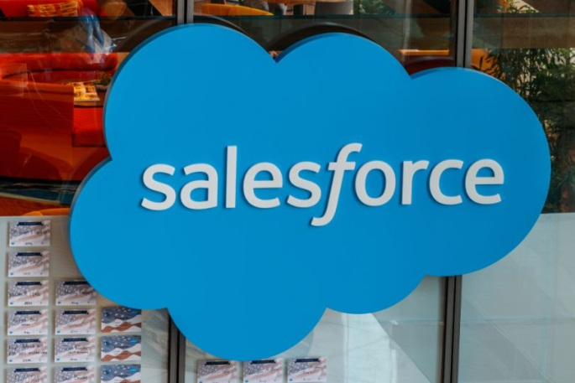
Salesforce
SaaS provider
CRM (customer relationship management) tool that helps businesses manage customer relations and generate sales leads.
The Sales Cloud combines A.I. and customer data to help sales teams identify potential leads and close sales faster.
The platform also has separate clouds for customer service and marketing.

Slide 20

AWS – Amazon Web Services
Amazon’s AWS (Amazon Web Services) has grown into the largest public cloud globally
It accounted for 38.9% of the IaaS market worldwide in 2021, according to Gartner
This section is also the largest profit source for Amazon
AWS Lambda lets developers run code for any application or backend service without provisioning or managing servers
The pay-as-you-go model continuously scales along with a business to accommodate for real-time shifts in data storage and usage

Slide 21
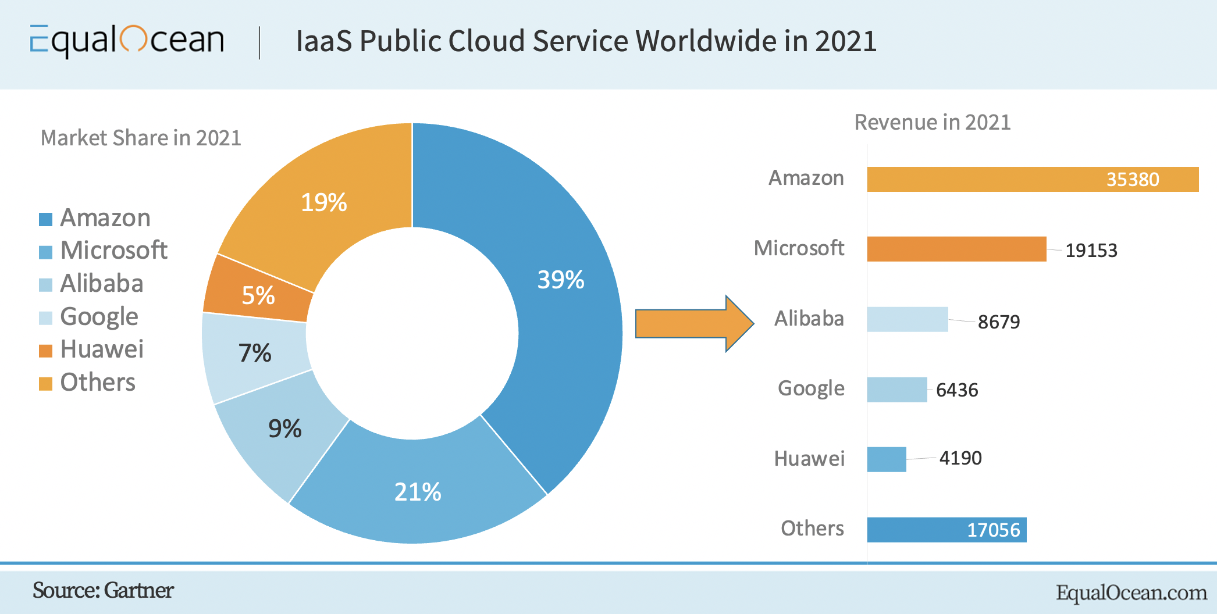

Slide 22
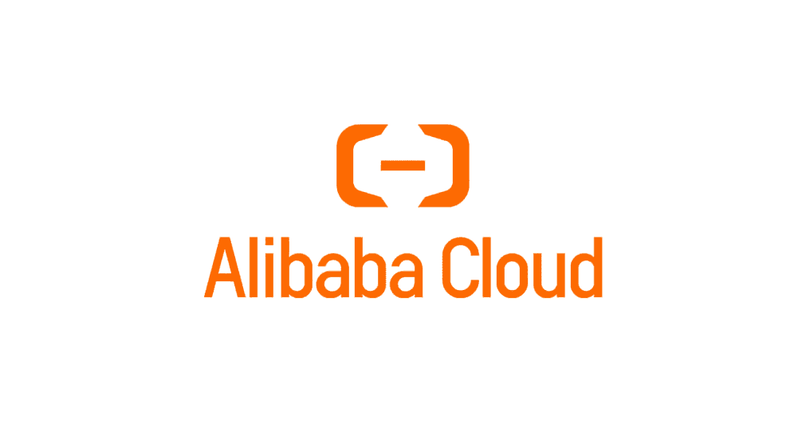
Alibaba Cloud 阿里云
The largest cloud computing company in China and in Asia Pacific
Offers cloud services that are available on a pay-as-you-go basis
elastic compute
data storage
relational databases
big-data processing
anti-DDoS protection
content delivery networks (CDN)
Alibaba Cloud provides cloud computing IaaS, PaaS, DBaaS and SaaS, including services which can be managed from Alibaba web page or using aliyun command line tool.
e-commerce
big data
Database
IoT
Object storage (OOS)
data customization
…

Slide 23
A quick review

Slide 24

Poll
Remark
1 answer(s) at most
A cloud computing is a computing paradigm in which ….
Cloud computing is the delivery of different services through the Internet, which includes tools and applications like data storage, servers, databases, networking, and software.
A
User buys software on CD
B
Everyone owns and manages their own computing infrastructures, development platforms and software
C
Resources such as files, data, programs, hardware, and software can be accessible from a Web browser via the Internet to users
Submit
Text\Image\Formula are allowed and all the content should be placed in this area

Slide 25
Multiple Choice(single)
Points: 1
Remark
A cloud computing is a computing paradigm in which ….
Cloud computing is the delivery of different services through the Internet, which includes tools and applications like data storage, servers, databases, networking, and software.
A
User buys software on CD
B
Everyone owns and manages their own computing infrastructures, development platforms and software
C
Resources such as files, data, programs, hardware, and software can be accessible from a Web browser via the Internet to users
Submit
Text\Image\Formula are allowed and all the content should be placed in this area

Slide 26
Cloud computing definition
Cloud computing is the delivery of different services through the Internet, which includes tools and applications like data storage, servers, databases, networking, and software.

Slide 27
Cloud computing definition
Cloud computing is the on-demand availability of computer system resources, especially data storage (cloud storage) and computing power, without direct active management by the user.
Large clouds often have functions distributed over multiple locations, each location being a data center.
Cloud computing relies on sharing of resources to achieve coherence and typically using a "pay-as-you-go" model which can help in reducing capital expenses but may also lead to unexpected operating expenses for unaware users.

Slide 28
Cloud Computing Characteristics
Essential Characteristics:
On Demand Self-Service
Broad Network Access
Rapid Elasticity
Resource Pooling
Measured Service
Other Common Characteristics:
Massive Scale
Resilient Computing
Homogeneity
Geographic Distribution
Virtualization
Service Orientation
Low Cost Software
Advanced Security

Slide 29
Five essential characteristics of cloud computing
On-demand self-service
Broad network access
Resource pooling
Rapid elasticity
Measured service

Slide 30
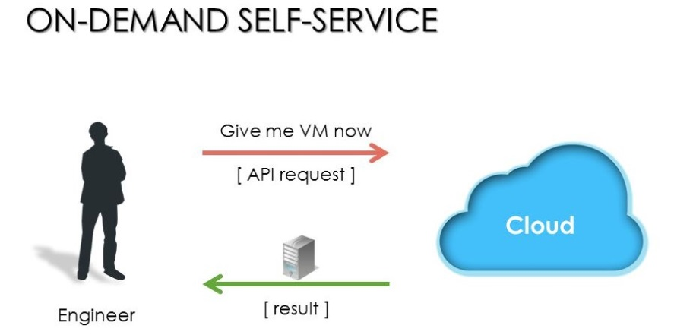
On-demand self-service
A consumer can automatically provision computing capabilities for almost any type of workload on demand, server time
network storage
Eliminating the traditional need for IT administrators to provision and manage compute resources.
“no-need-to-know” in terms of the underlying details of infrastructure, applications interface with the infrastructure via the APIs.

Slide 31
Five essential characteristics of cloud computing
On-demand self-service
Broad network access
Resource pooling
Rapid elasticity
Measured service

Slide 32
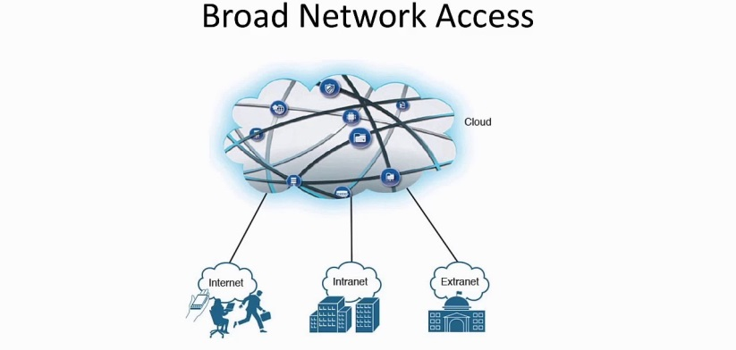
Broad network access
Capabilities are available over the network and accessed through standard mechanisms that promote use by heterogeneous thin or thick client platforms (e.g., mobile phones, tablets, laptops, and workstations).
A user can access cloud data or upload data to the cloud from anywhere with an internet connection using any device.

Slide 33
Five essential characteristics of cloud computing
On-demand self-service
Broad network access
Resource pooling
Rapid elasticity
Measured service

Slide 34
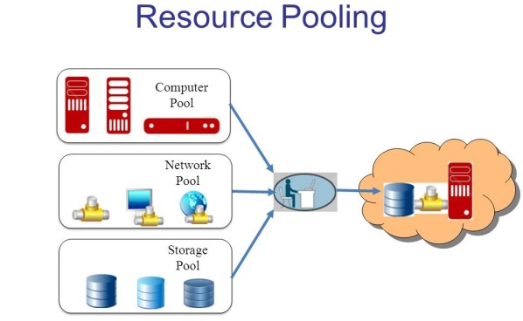
Resource pooling
The provider's computing resources are pooled to serve multiple consumers using a multi-tenant model, with different physical and virtual resources dynamically assigned and reassigned according to consumer demand.
Multi-tenant model lets numerous customers share the same physical infrastructures or the same applications yet still retain privacy and security over their own data.
With resource pooling, cloud providers service numerous customers from the same physical resources.

Slide 35
Five essential characteristics of cloud computing
On-demand self-service
Broad network access
Resource pooling
Rapid elasticity
Measured service

Slide 36
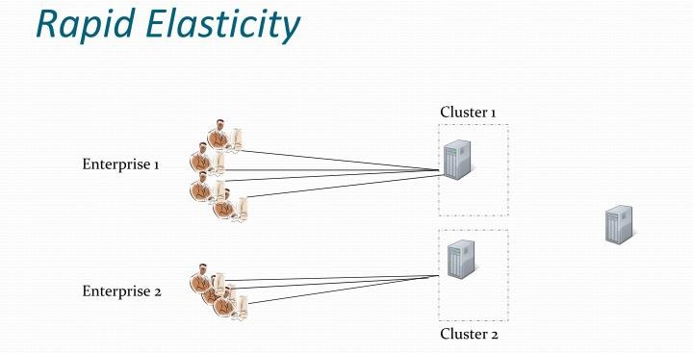
Rapid elasticity
Capabilities can be elastically provisioned and released, in some cases automatically, to scale rapidly up and down commensurate with demand.
To the consumer, the capabilities available for provisioning often appear unlimited and can be appropriated in any quantity at any time.
CPU
Storage
Server capacity
Load balancing
Databases
This eliminates the need for massive investments in local infrastructure, which might or might not remain active.

Slide 37
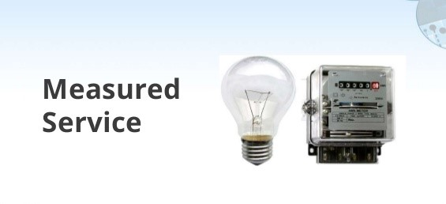
Measured service
Cloud systems automatically control and optimize resource use by leveraging a metering capability at some level of abstraction appropriate to the type of service (e.g., storage, processing, bandwidth, and active user accounts).
Resource usage can be monitored, controlled, and reported, providing transparency for both the provider and consumer of the utilized service.
“pay as much as used and needed”

Slide 38
Cloud Computing Characteristics
Essential Characteristics:
On Demand Self-Service
Broad Network Access
Rapid Elasticity
Resource Pooling
Measured Service
Other Common Characteristics:
Massive Scale
Resilient Computing
Homogeneity
Geographic Distribution
Virtualization
Service Orientation
Low Cost Software
Advanced Security

Slide 39
Other characteristics
Scalability
Infrastructure capacity allows for traffic spikes and minimizes delays.
Resiliency
Cloud providers have mirrored solutions to minimize downtime in the event of a disaster. This type of resiliency can give businesses the sustainability they need during unanticipated events.
“always on!, anywhere and any place”
Homogeneity
No matter which cloud provider and architecture an organization uses, an open cloud will make it easy for them to work with other groups, even if those other groups choose different providers and architectures.

Slide 40
Cloud computing origin
Origin of the name
why “cloud”?
Origin of the technology
evolution of cloud computing

Slide 41
Cloud computing origin
Origin of the name
why “cloud”?
Origin of the technology
evolution of cloud computing

Slide 42

What is “cloud”?

Slide 43
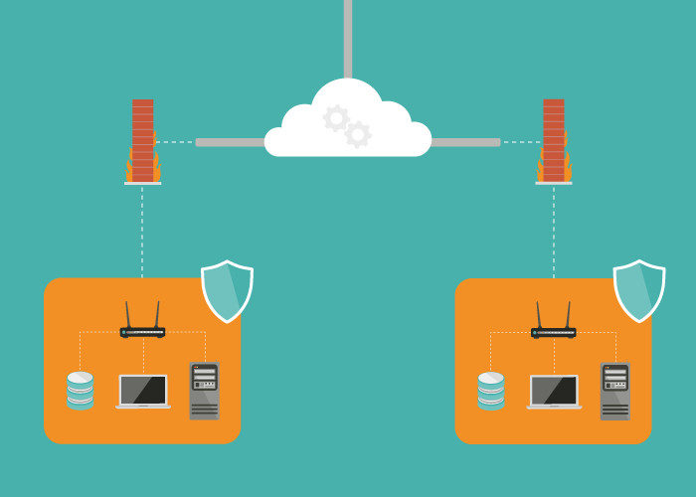
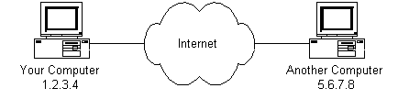
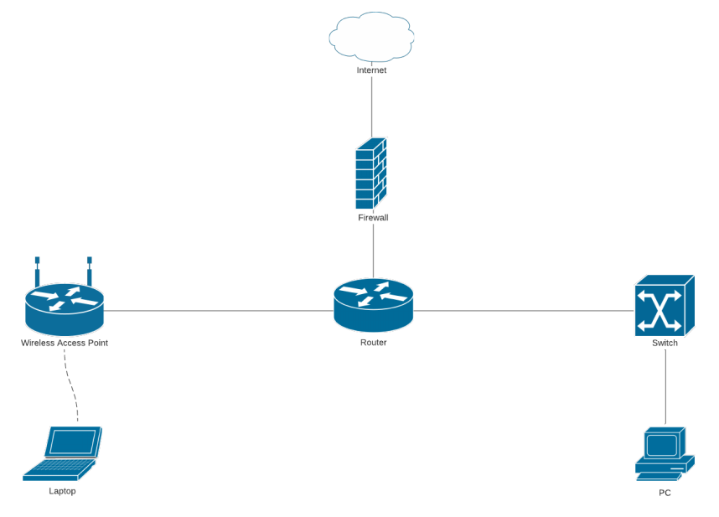
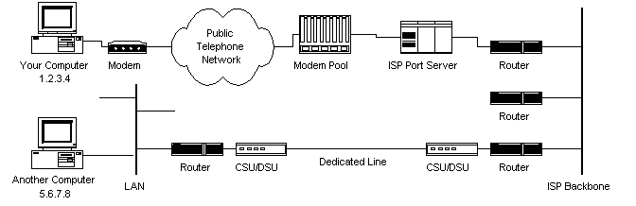
What symbol is used to represent the Internet in these flow charts and diagrams?

Slide 44
Open Question
Points: 10
What symbol is used to represent the Internet in these flow charts and diagrams?
Open Question is only supported on Version 2.0 or newer.
Answer

Slide 45
Cloud as a symbol of Internet
Recall our definition of cloud computing
Cloud computing is a general term for anything that involves delivering hosted service over the Internet
The name “cloud computing” was inspired by the cloud symbol that’s often used to represent the Internet in flow charts and diagrams

Slide 46
Cloud as a symbol of Internet in diagrams

Slide 47
Cloud as a symbol of Internet in diagrams

Slide 48

Cloud as a symbol of Internet in diagrams

Slide 49
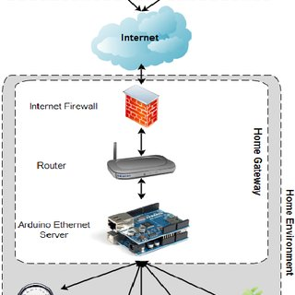
Cloud as a symbol of Internet in diagrams

Slide 50
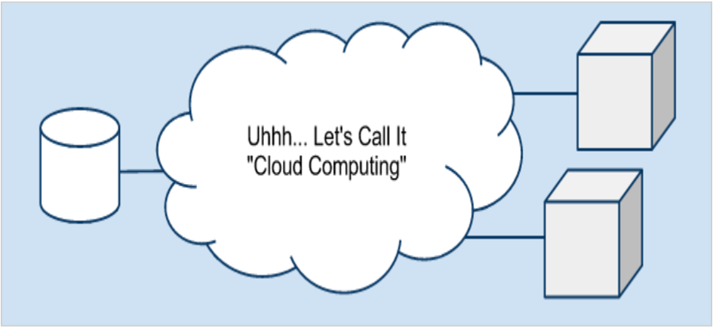
Cloud as a symbol of Internet in diagrams
One relevant quote " Cloud comes from the early days of Internet where we drew the network as a cloud... we didn't care where the message went- the cloud hid it from us " , Kevin Marks, Google Engineer

Slide 51
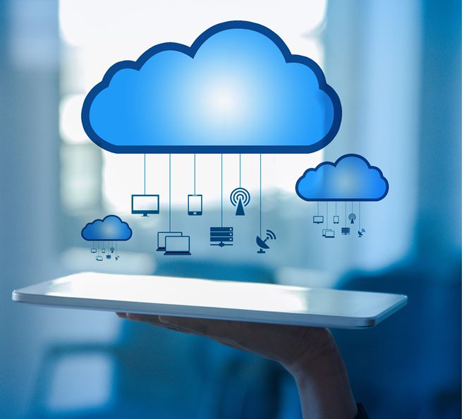
Cloud as a metaphor for virtual space
In cloud computing, the information being accessed is
found remotely in the cloud or a virtual space.
Companies that provide cloud services enable users to store files and applications on remote servers and then access all the data via the Internet.
This means the user is not required to be in a specific place to gain access to it, allowing the user to work remotely.
That virtual space becomes the cloud —your data, work, and applications are available from any device with which you can connect to the Internet, anywhere in the world.

Slide 52
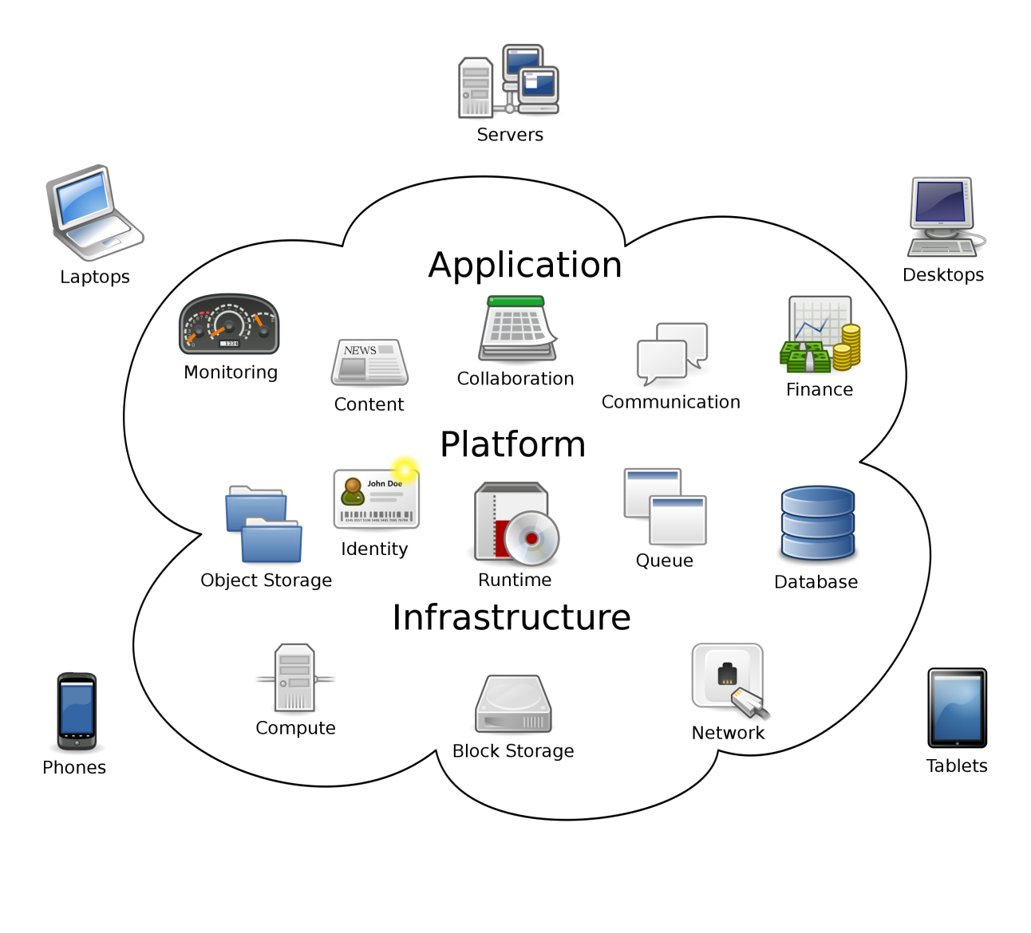
Cloud as a metaphor for virtual space (2)
Cloud computing metaphor: the group of networked elements providing services need not be individually addressed or managed by users; instead, the entire provider-managed suite of hardware and software can be thought of as an amorphous cloud
amorphous - without a clearly defined shape or form

